Slide 1


Slide 2
OUTLINE
Executive Summary
Introduction
Methodology
Results
Conclusion

Slide 3
EXECUTIVE SUMMARY
The gaming industry has experienced significant growth in recent years, with an increasing number of players and revenue streams. As such, understanding the dynamics of the gaming market and consumer preferences is crucial for gaming companies to stay competitive. In this analysis, we examined an undocumented dataset from a JustDice company to gain insights into key metrics and trends. The datasets, spanning a period of one year, included information on installs demographics, device os version used, network_id used, app_id installed, client_id of adspend and value in USD of ad spend, payouts, and revenue.
Based on the findings of our analysis, we recommend these and more strategies for the gaming company.
Optimize in-game purchases: Continuously analyze and optimize the in-game purchase offerings, including pricing, promotions, and virtual goods, to drive higher revenue and player engagement.
Increase Installs retention efforts: Implement strategies to retain players, such as regular updates, new content, and community engagement, to maintain player loyalty and encourage long-term engagement.
Use A/B testing for ads campaigns and the marketing team should work with the analytics team to know which app_id, device_os_versions, and network_id of installs to direct their marketing campaign.
In conclusion, the insights gained from this analysis provide valuable information for the company to make data-driven decisions and optimize its business and marketing strategies. By understanding installs demographics, network_id, device os version used, etc, the company can make informed decisions to enhance installers’ experience, increase revenue, and stay competitive in the dynamic gaming market

Slide 4
INTRODUCTION
Project background and context
The aim of this project is to give a financial overview of the company and the user acquisition process with four datasets given Installs, Adspend, Payouts, and Revenue.
Problems we want to find answers
- The Financial situation of the company
- The user acquisition and conversion rate

Slide 5


Slide 6
METHODOLOGY
Summary of methodologies
- Data Wrangling and Cleaning
- Exploratory Data Analysis with Data Visualization
Summary of all results
- Exploratory Data Analysis Summary of Results
The link to the repository for the analysis:
https://github.com/Believened/JustDice/blob/main/JustDice.ipynb

Slide 7
Data Wrangling and Cleaning
The company’s undocumented data was collected from the GitHub repository given, and the content was downloaded.
The data was read into pandas’ data frames
The data was thoroughly looked through
I checked for missing values and duplicates
All duplicates were dropped
Fields were assigned to the right data types
Outliers were removed to ensure the data was not skewed.

Slide 8
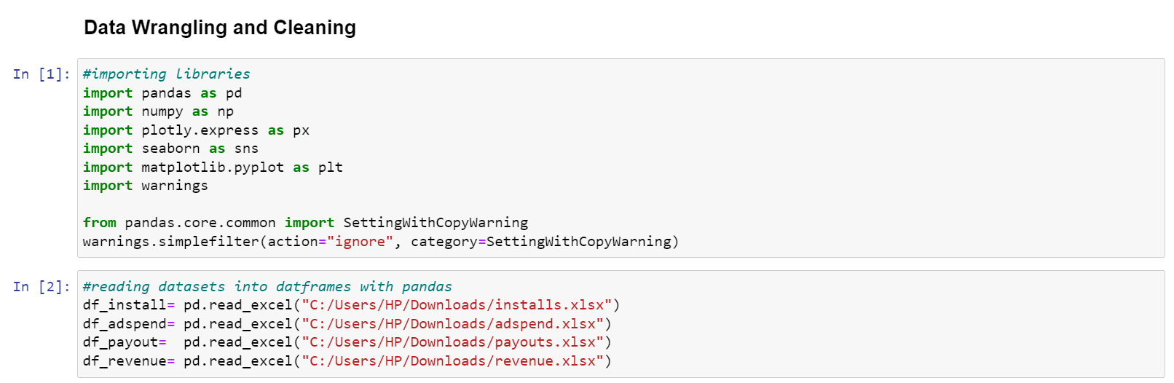
Data Wrangling and Cleaning
The data were read into dataframes with pandas

Slide 9
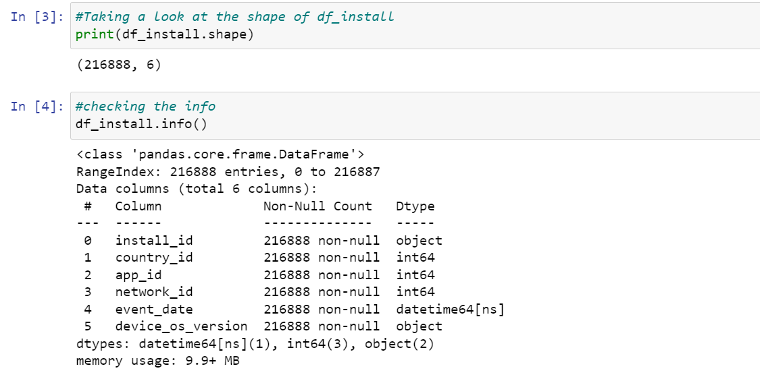
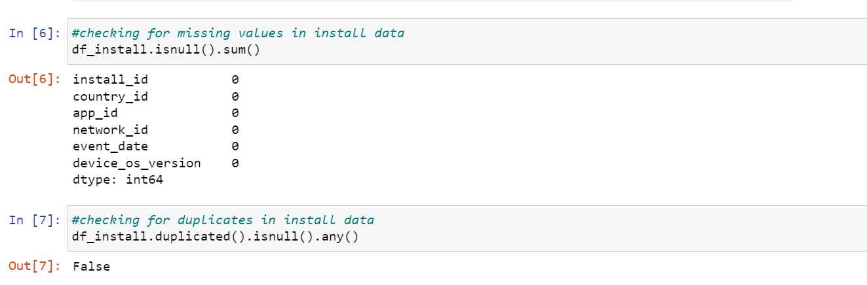
Data Wrangling and Cleaning
The properties of each dataframe were checked.
Missing values and Duplicates were checked.

Slide 10
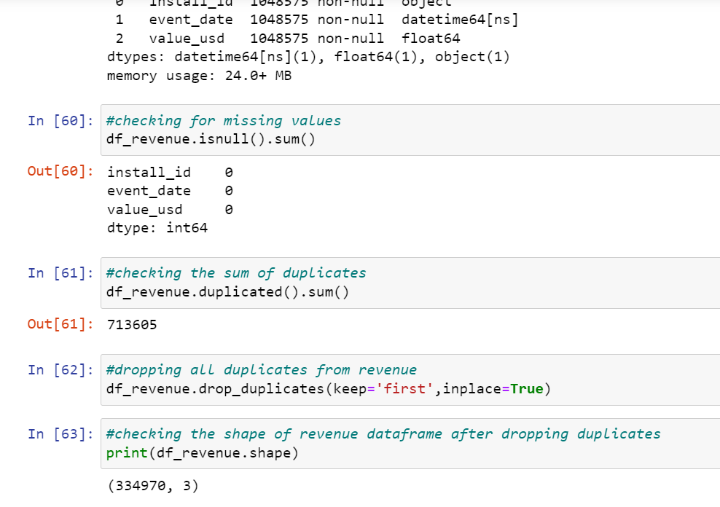
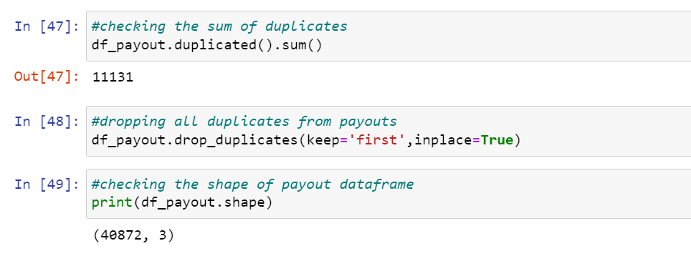
Data Wrangling and Cleaning
All duplicates were dropped from all data. While installs had only one duplicate, and Adspend has no duplicates, it is quite noticeable that;
The Payouts data that had 52,003 rows dropped to 40,872 rows and
Revenue data that had 1,048,575 rows dropped to 334,970 rows with about 68% of its data being duplicated.

Slide 11
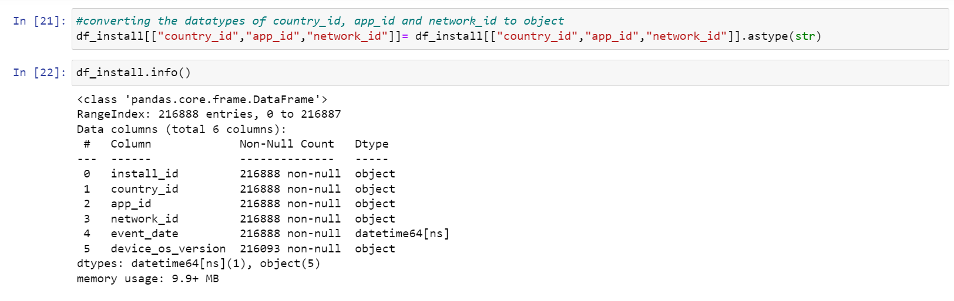
Data Wrangling and Cleaning
All fields were checked to ensure it has the right data types and the fields with the wrong data type were converted to the right data type.

Slide 12
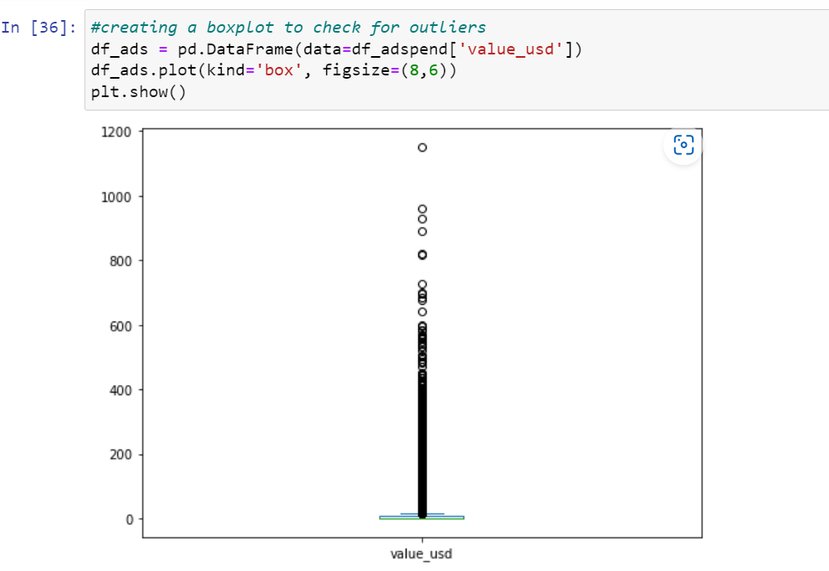
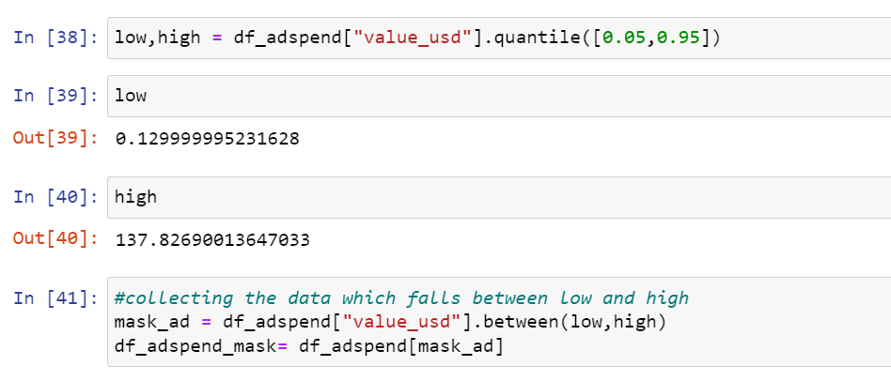
Data Wrangling and Cleaning
Adspend, Payout, and Revenue (all data containing value_usd) were checked for outliers, and only data between 5% to 95% was taken.

Slide 13
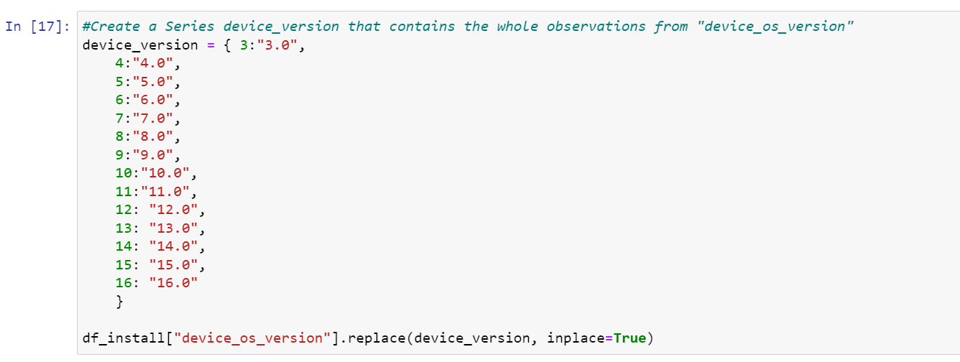
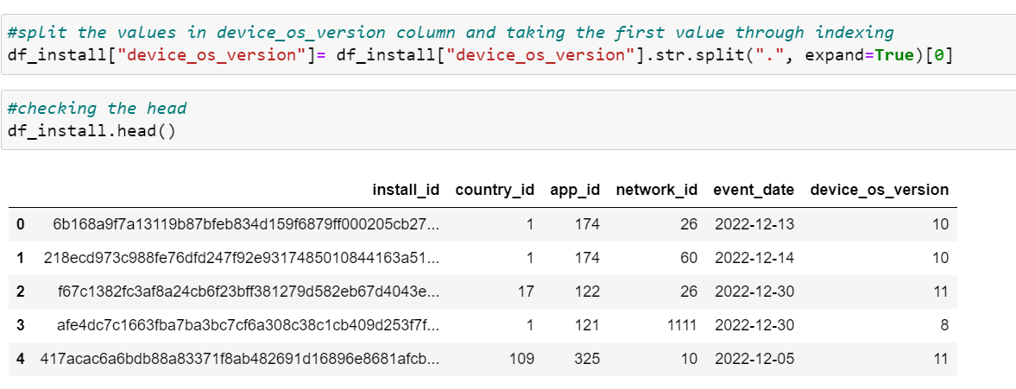
Data Wrangling and Cleaning
Other data cleaning processes were done also, like keeping the data format consistent as seen in device_os_version of installs data.

Slide 14
Exploratory Data Analysis with Data Visualization
I explored the data by visualizing the fields of installs and adspend to how our ads are reaching our installers.
Bar charts, Histograms were used to categorically display the frequency of each field, and Pie charts to display the proportions.
A line graph was used to display the monthly trend average value in USD spent on Ads(Adspend), Payouts, and Revenue.

Slide 15


Slide 16
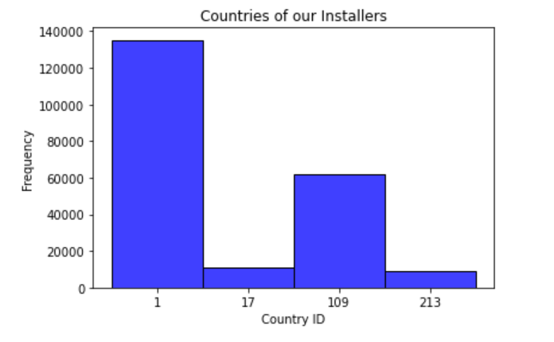
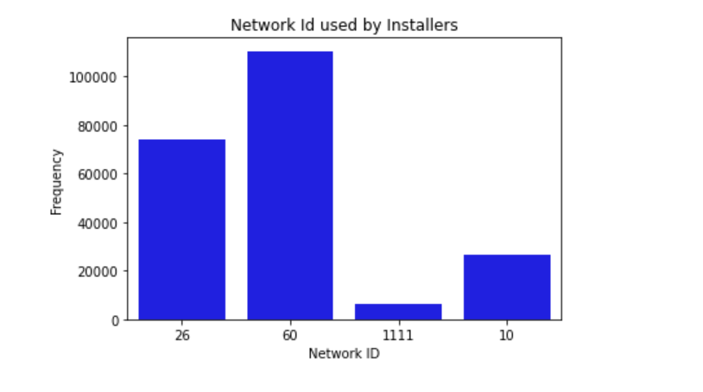
EDA with Data Visualization
The histogram on the left shows the Country ID of the installs. We can find that country_id 1 tops the countries of our users, followed by country_id 109.
The column chart shows the network_id used by the installers, with network_id 60 being the most used network followed by network_id 26.

Slide 17
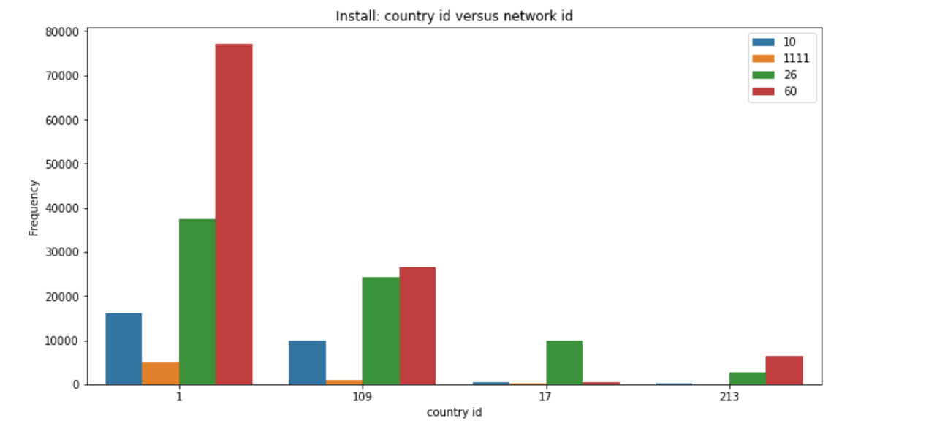
EDA with Data Visualization
Having looked at both the countries of the installers and the network_id used by them, I did used groupby method to display how the network_id was used in these countries. We can see that network_id 26 is a strong competitor of network_id 60 which tops our list of networks used.

Slide 18
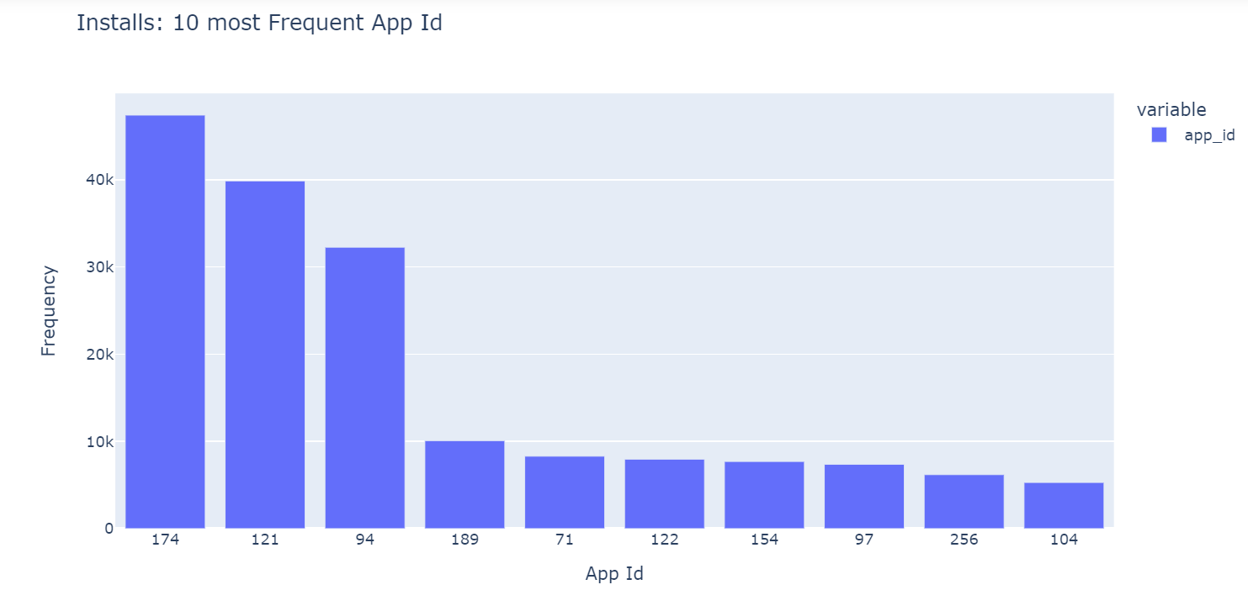
EDA with Data Visualization
Then we used plotly to visualize the app_id from our installs data. We can find that our Installers installed App_Id 174, 121, and 94 the most.

Slide 19
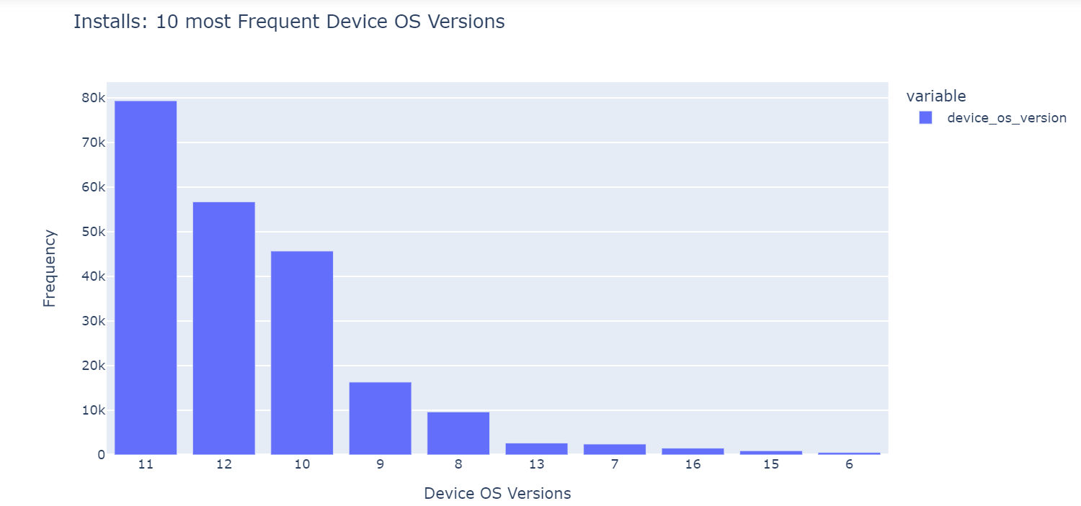
EDA with Data Visualization
Using plotly to visualize the device os version used by the installers, we can find that our installer mainly used device os versions 11, 12, and 10 respectively.

Slide 20
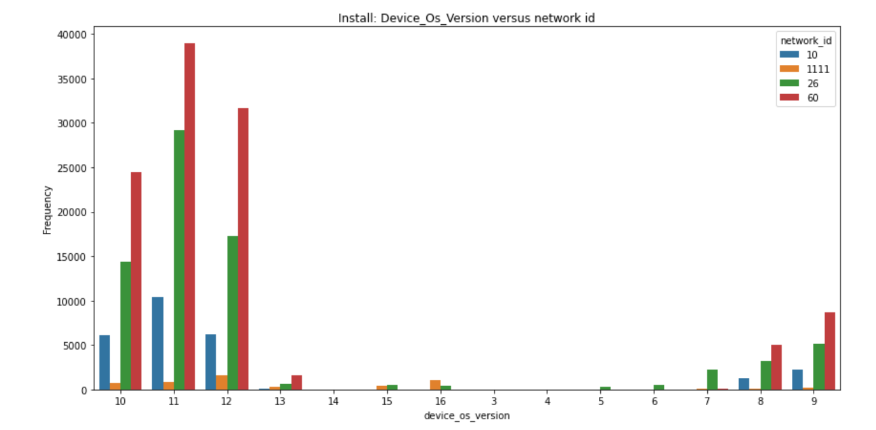
EDA with Data Visualization
Then we used group-by method and created a side-by-side bar chart to display which network_id was used the most across all device os versions and we found that across our most used device os versions(11, 12, and 10), network_id 60 and 26 were the most used network.

Slide 21
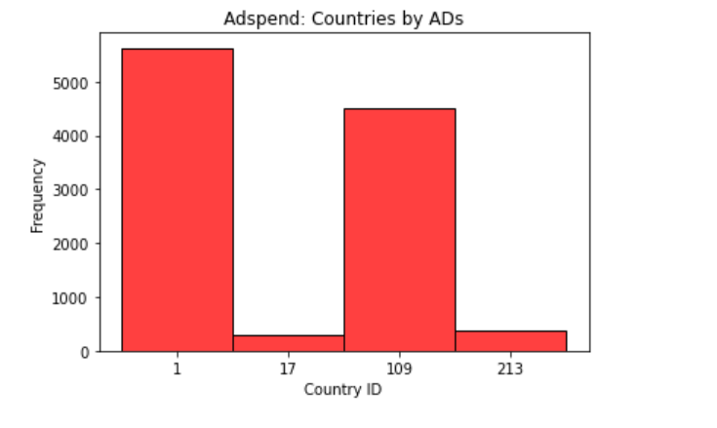
EDA with Data Visualization
Now, we looked at adspend and visualized the countries we spent the most on ads in a histogram. We found that while we spent more on the country with the most installs, we were spending almost the same amount allocated for ads to country_1, to country_id 109, when country_id 1 has by far a larger amount of installs.

Slide 22
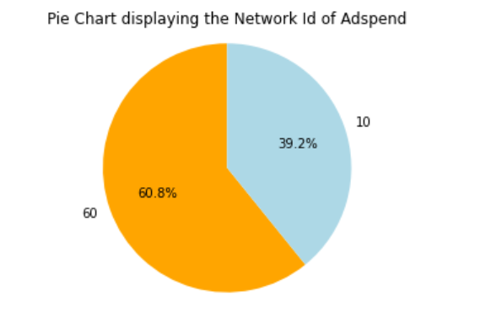
EDA with Data Visualization
From the Pie chart below, we also discovered that our ads were only on network_id 10 and 60. While spending on ads on network_id 60 was a good acquisition strategy, our strongest competitor with network_id 60 for the most network used across countries and device os versions of our installers, network_id 26 was not reached at all.

Slide 23
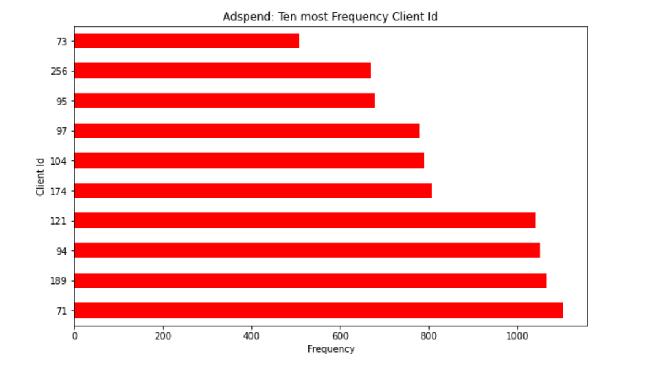
EDA with Data Visualization
With the client_id of adspend having a relationship with the app_id of the installs, visualizing the client_id, we found out that our ads were not targeted at our most installed app_id. While the most installed app_id were 174, 121, and 94, we spent the most money on ads on id 71, 189, and 94.

Slide 24
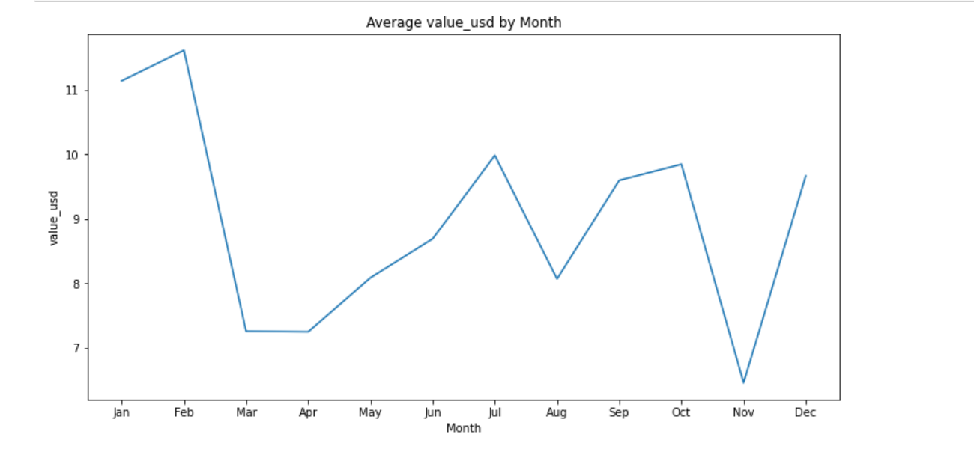
EDA with Data Visualization
The line plot shows the trend of our average adspend during the months of the year. There was a peak in February with the average adspend at 11.5 per month before the decline to a low of 7.3 from February to March. There was a significant increase from 6.5 to 9.6 from November to December and also an increase from the low of 7.3 made in April to 9.8 in July with another drop from July to August setting another low of 8, and then an increase from August to October reaching 9.7, and decline from October to November setting a new low of 6.5 which it rapidly increased to 9.6 in December

Slide 25
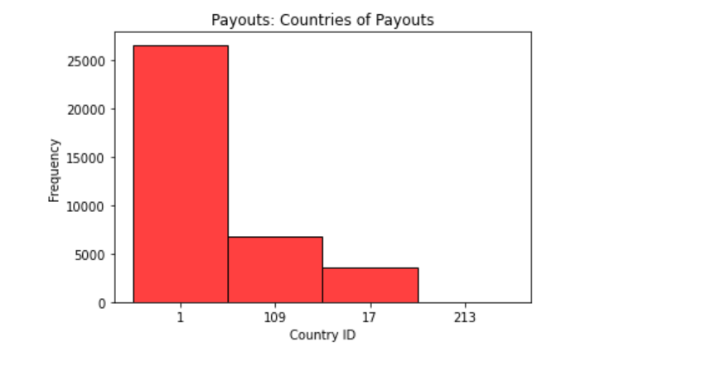
EDA with Data Visualization
The payout and install datasets were merged on the common column “install_id”(inner). We then proceed to visualize the country of our payouts with a histogram. Country_id 1 has the most payouts, followed by country_id 109.

Slide 26
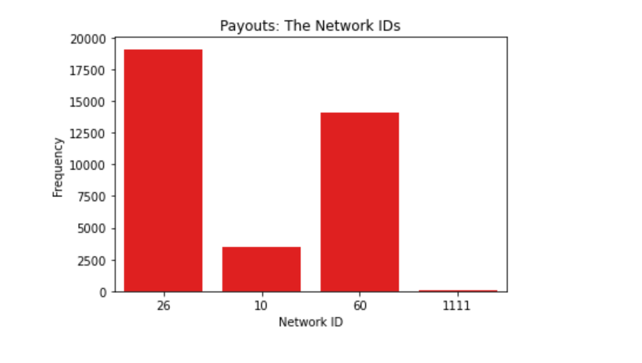
EDA with Data Visualization
Then we created a bar chart to display the network_id that had the most payouts. Network Id 26 ranks top for the most payouts, followed by network_id 60.

Slide 27
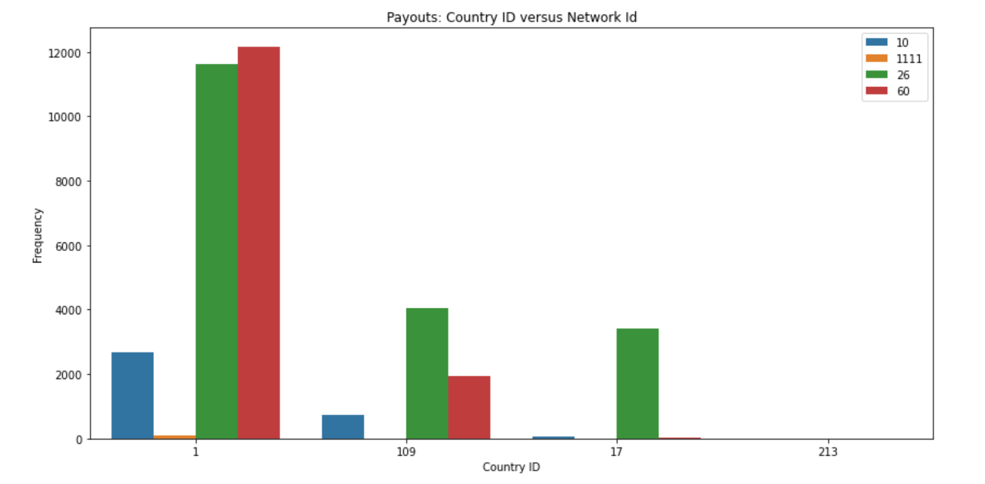
EDA with Data Visualization
To know how the payouts were done in the countries and the network_id involvement in it, we created a side-by-side bar chart to display the countries and the network_id as hue. We discovered that while we had large payouts on network_id 26 in country_id 1, we had slightly more payouts on network_id 60, and for other countries, we had more payouts on network_id 26

Slide 28
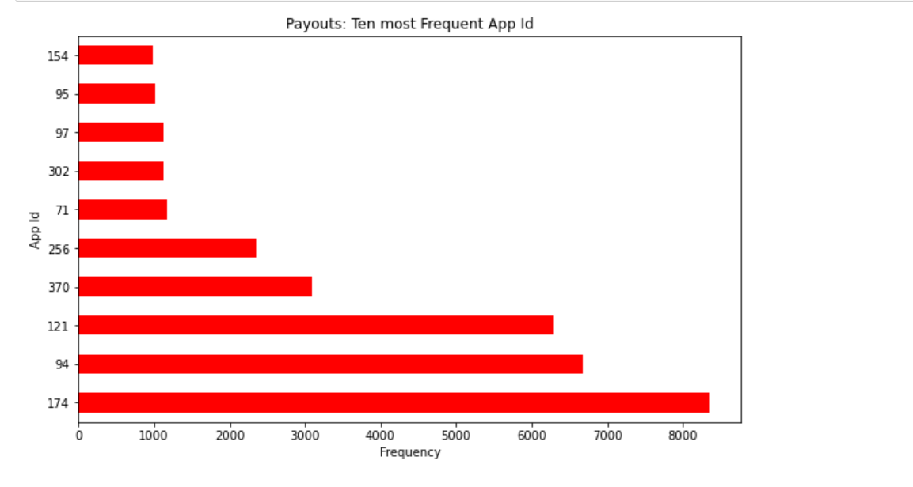
EDA with Data Visualization
Another a horizontal bar chart was created to explore the App ID of the payouts made. We found that App_id 174, 94, and 121 are the most app_id involved in our payouts, with app_id 174 topping the list and relatively the same amounts for App_id 94 and 121.

Slide 29
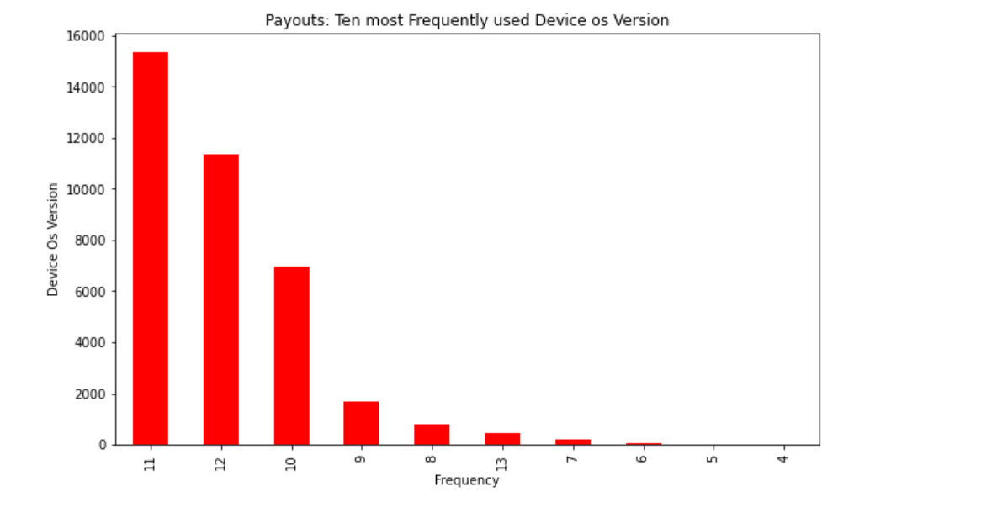
EDA with Data Visualization
The device os version of the payouts was also visualized and it was noticeable that device os versions 11, 12, and 10 are the most devices version involved in our payouts

Slide 30
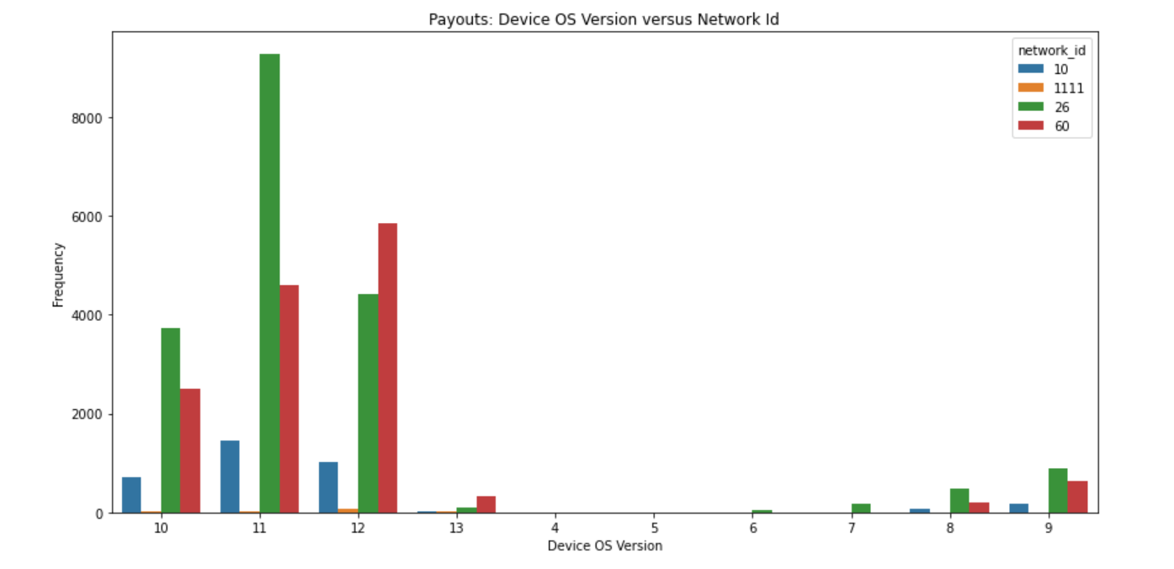
EDA with Data Visualization
To know more about the payouts on device_os_versions, we used a groupby method to display how the payout was with the device os versions and the network_id used in the device os versions, we found that with network_id 26 coming top of payouts on device os versions 11, 10, 9 and 8, we had more payouts on network_60 for device os version 12.

Slide 31
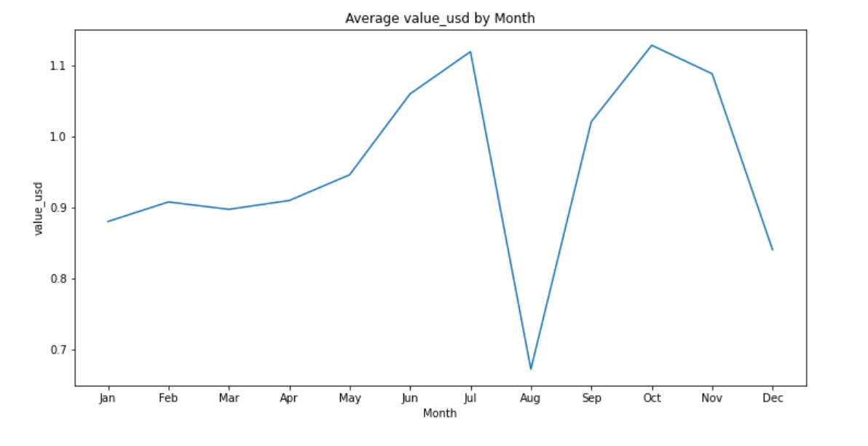
EDA with Data Visualization
From our chart below, the average payouts per month of the company increased steadily from January to July to a high of 1.1 and a sharp decline from July to the month of August and made a low of 0.6. A rapid increase from 0.6 in the month of August making a second peak at a new high of 1.2 in the month of October and dropping to 0.85 from November to December

Slide 32
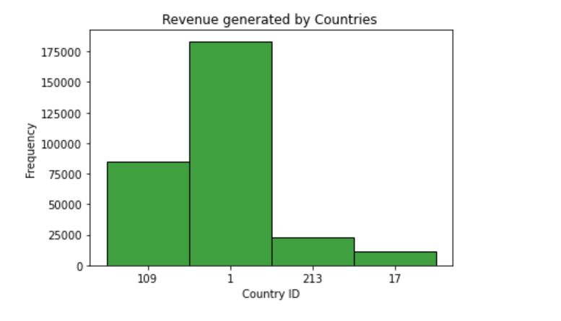
EDA with Data Visualization
The installs and revenue data were merged on the common column “install_id” to gain insights into how the revenue was generated. A histogram was created to display the countries generating revenue, which unsurprisingly country_id 1 topped the chart

Slide 33
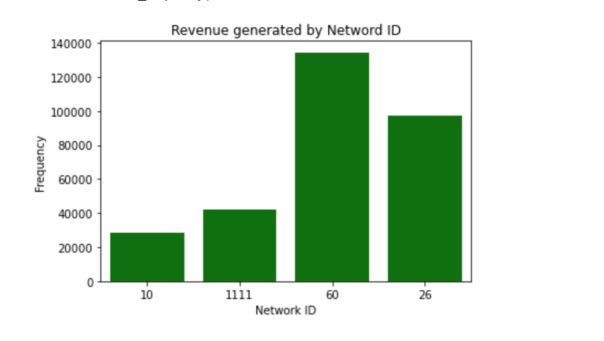
EDA with Data Visualization
Visualizing the revenue generated by the network_id’s, we can deduce that while network_id 60 is generating the most of our revenue, network_id 26 is a strong competitor in revenue generation.

Slide 34
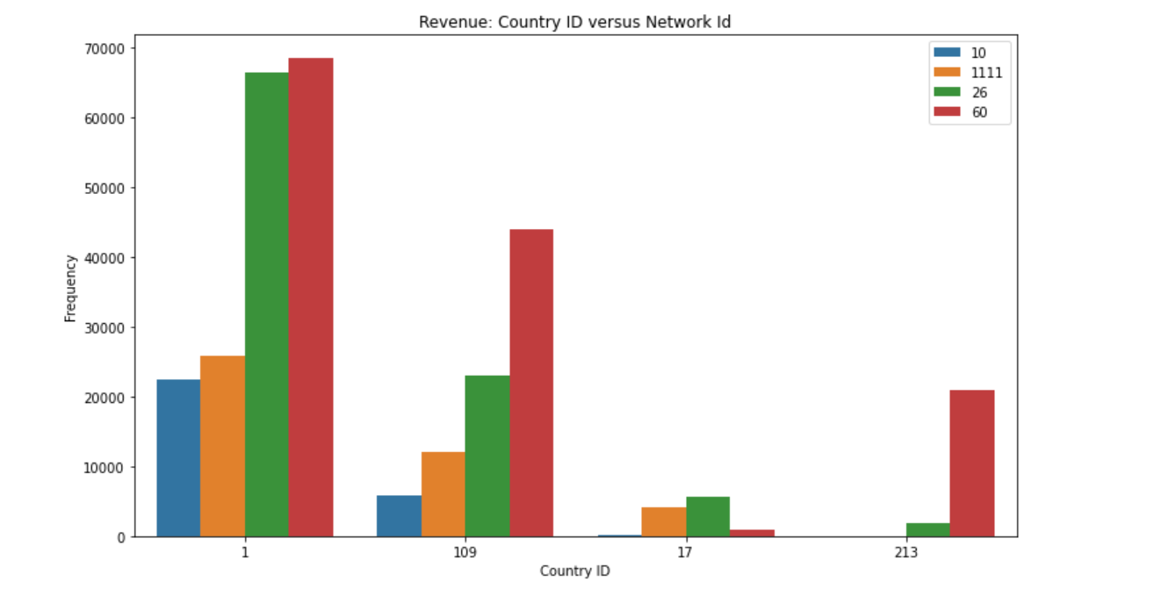
EDA with Data Visualization
To get a better understanding of how each network contributed to revenue generation in the countries of our installs, we created a side-by-side bar chart using groupby method and we found that network 26 is the second network_id generating the most revenue with network_id 60 topping the list. Network_id 1111 also outperformed network_id 10 in revenue generation, thus it can be deduced that we are wasting huge resources on ads for network_id 10 as it is generating low revenue

Slide 35
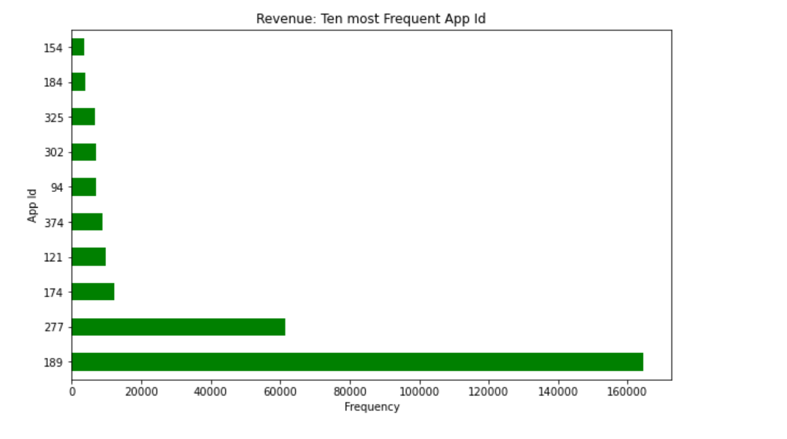
EDA with Data Visualization
Looking at the horizontal bar chart below, we can find that a huge part of our revenue was generated by app_id 189, this brings no surprise because this was the app_id our adspend was focused on. Thus if our ads were focused on the app_id with the most installs we will be generating more money

Slide 36
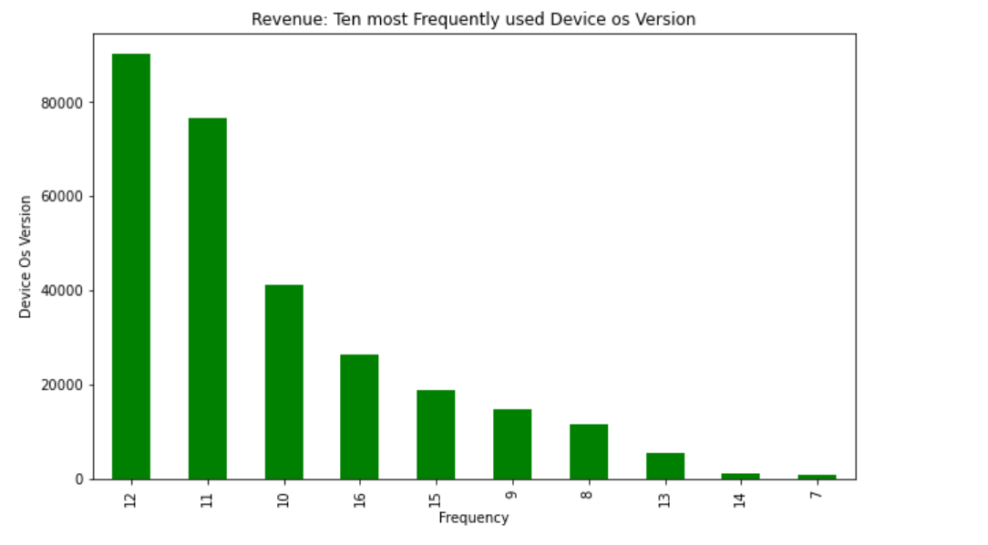
EDA with Data Visualization
Creating a bar chart to display the device_os_version generating revenue, Device_os_version 12, tops 11 and 10 in the most device version generating revenue for the company. This also comes as no surprise because device version 11 has network_id 26 as a huge part of its most netwrok_id users and this network_id was not reached by our ads at all. With device os version 12 having a considerably low amount of network_id 26, it tops the device os version generating revenue. This is also a reason for a low revenue as our apps most installers use device os version 11

Slide 37
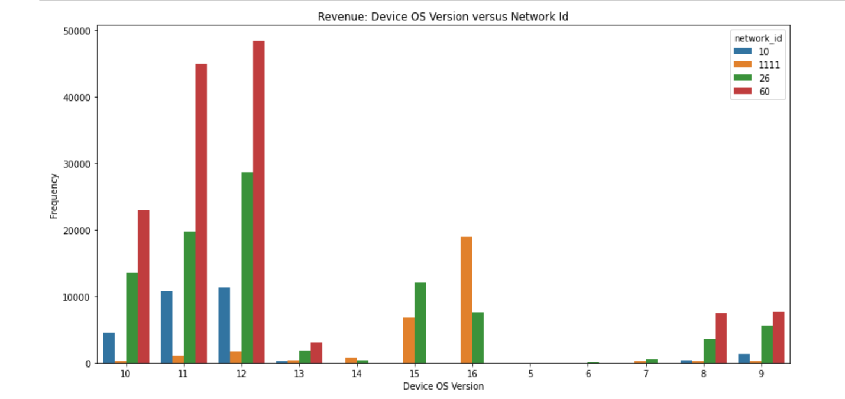
EDA with Data Visualization
We explored more into the device os version, to know how each network contributed to the revenue generated by the different device os versions, we found that with network_id 60 topping the chart in generating revenue across our installer’s most used device os versions, it also shows that network_id 26 is generating a good sum across all installers without any ad spent on it. Network_id 1111 tops for revenue generation in installers with device os versions 15 and 16.

Slide 38
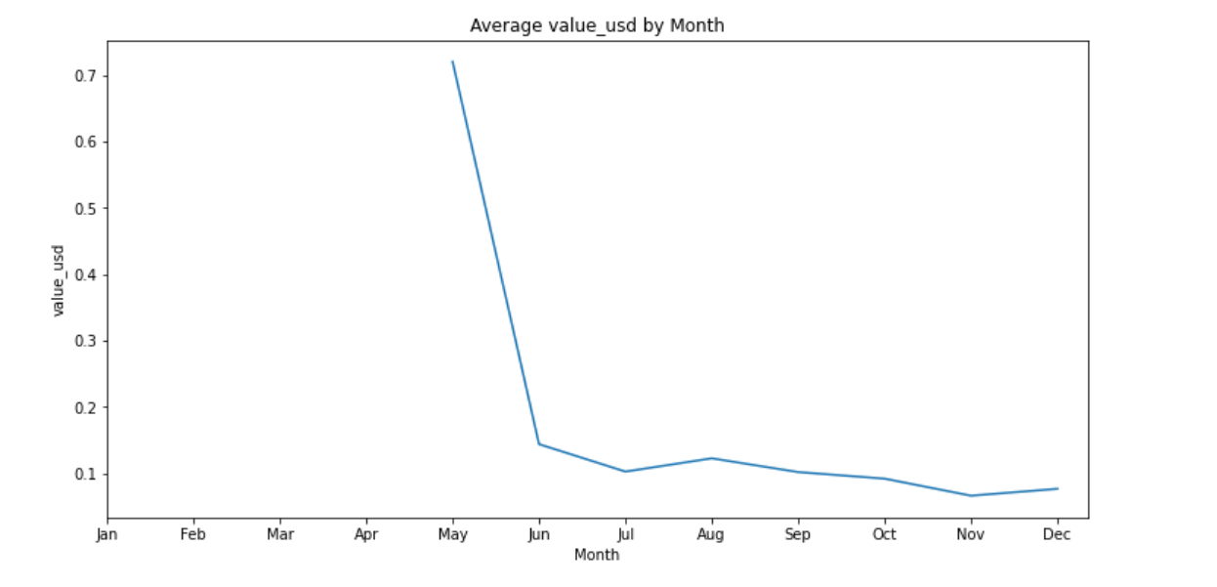
EDA with Data Visualization
The plot below of the average revenue per month shows a significant drop in revenue from 0.7 to a low of 0.12 from May to June and since then very few changes from the low it made. This shows there is little or no increase in the revenue generated from June till the end of the year.

Slide 39
EDA with Data Visualization
Summary of the exploratory analysis done with Data Visualization.
The installs are majorly from country_id 1 ad 109
Network_id 60 and 26 are the most used network by our installers
The app_id used the most by our installers are 174, 121 and 94
The most used device version of our installers are 11, 12 and 10
Our ads are only focused on network_id 60 and 10.
The company is spending almost the same amount of money on ads for country_id 1 and 109 despite country_id 1 having twice the amount of installers.
While the client_id in ads data is relative to app_id in install data, our ads are focused on id 71, 189, and 94.

Slide 40


Slide 41
RESULTS
Summary of the Company’s financial situation
Financial Overview of the company
Summary of the user acquisition process
Calculating the Key Performing Metrics of the Company

Slide 42
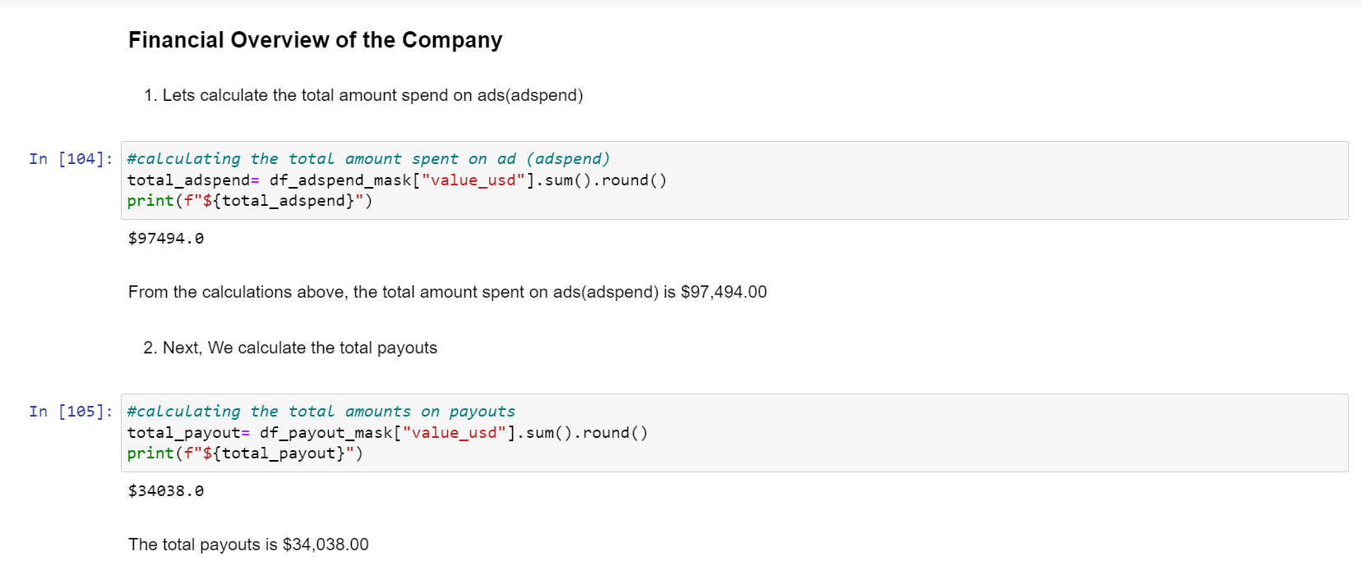
Financial Overview
We calculated the total adspend and total payouts consecutively which is the cost of the company

Slide 43
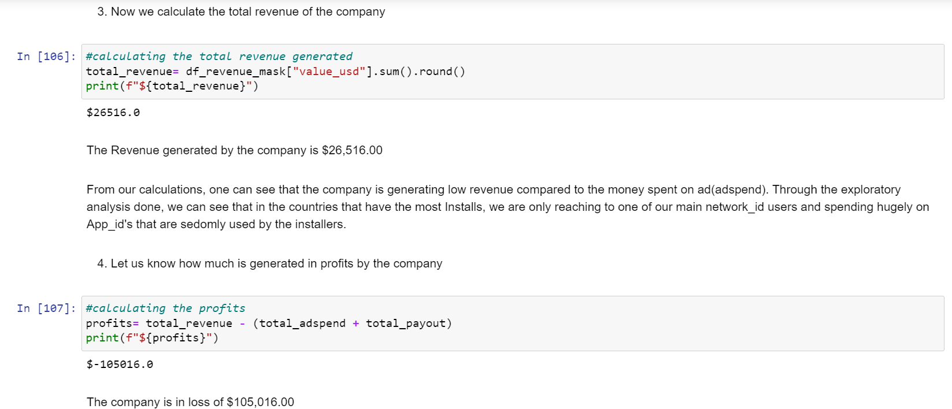
Financial Overview
From the trend of the average monthly revenue in usd, one can see that the company generated little revenue, thus putting the company in a loss of $105,016.00

Slide 44
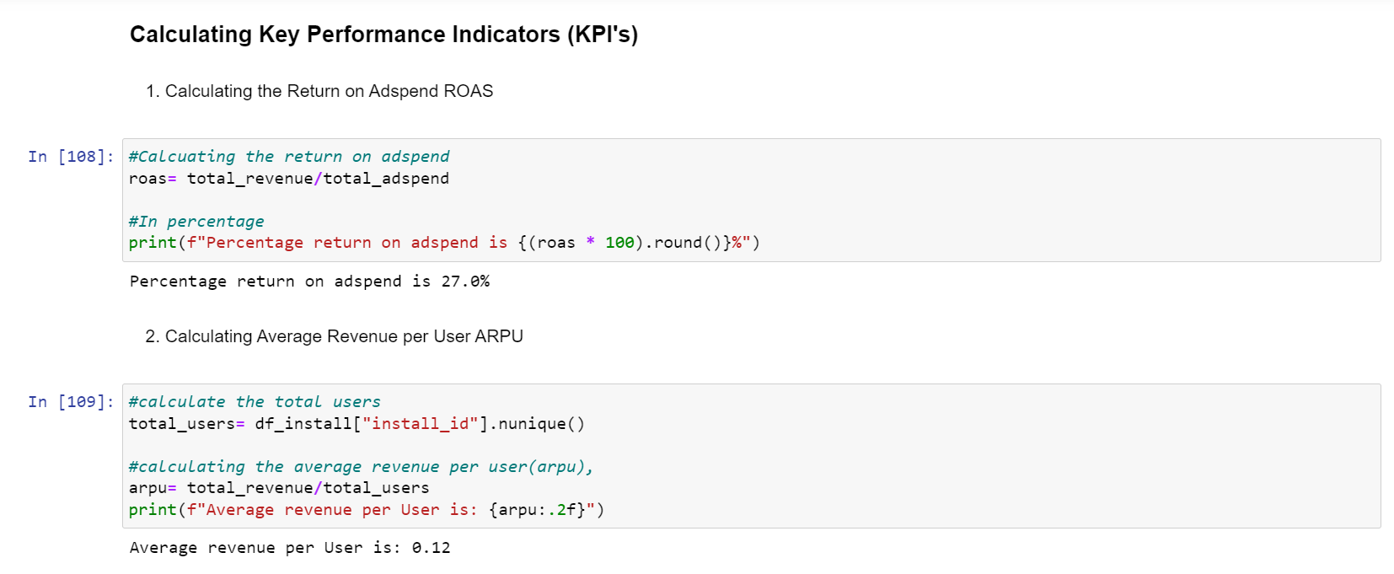
User Acquisition Process
We calculated some key performance indicators of the company to know about the user acquisition processes. Here we calculated the return on adspend(ROAS), and average revenue per user(ARPU).

Slide 45
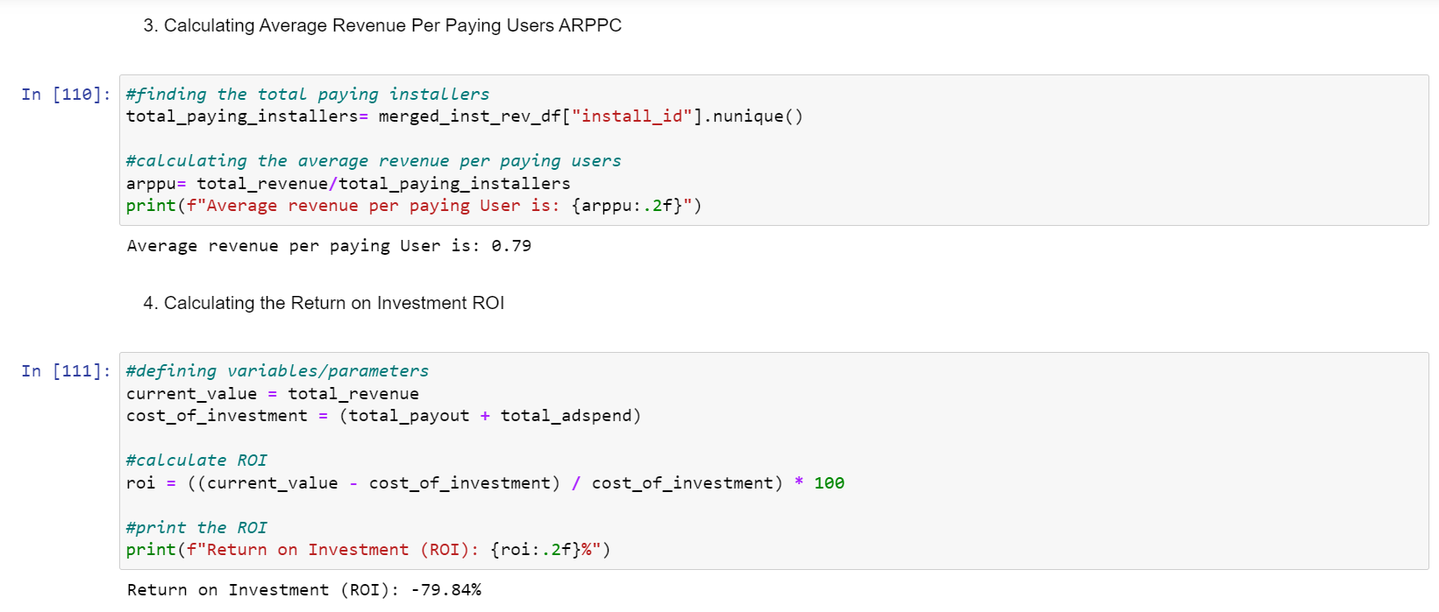
User Acquisition Process
Then we calculated the average revenue per paying user (ARPPU) and the return on investment (ROI).

Slide 46
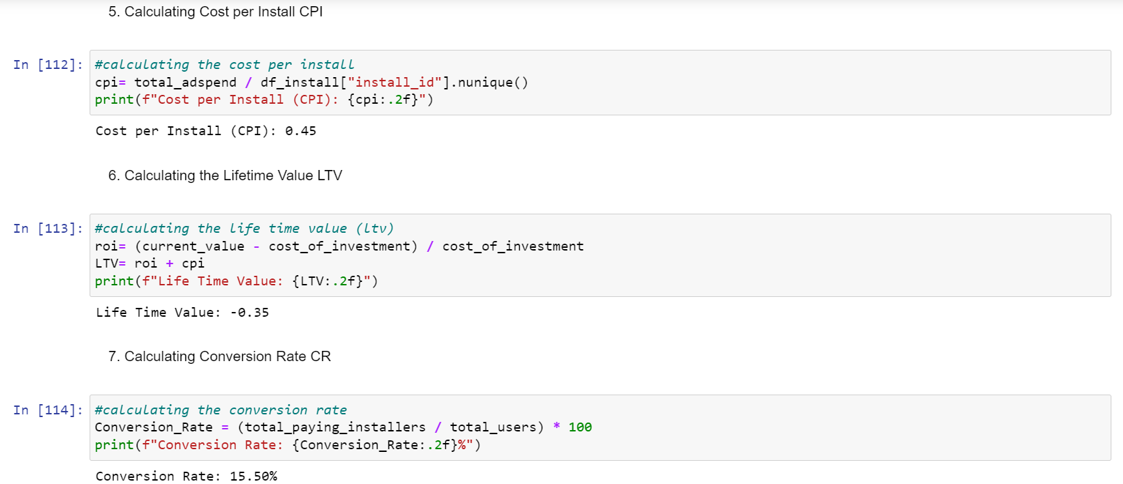
User Acquisition Process
We calculated the cost per install (CPI) given the amount the company spent on ads and payouts. The Life Time Value (LTV) and Conversion rate (CR) were calculated.

Slide 47
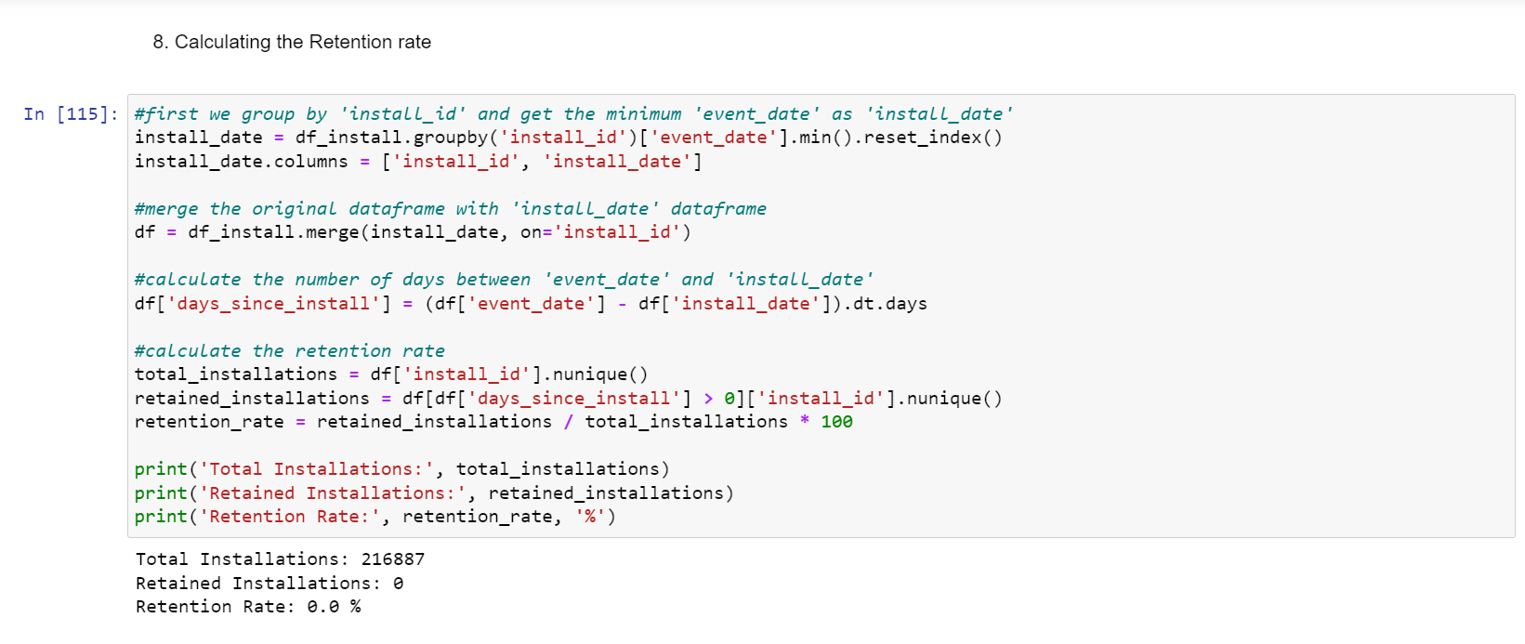
User Acquisition Process
We calculated the Retention rate and found that the company is not retaining installers at all

Slide 48
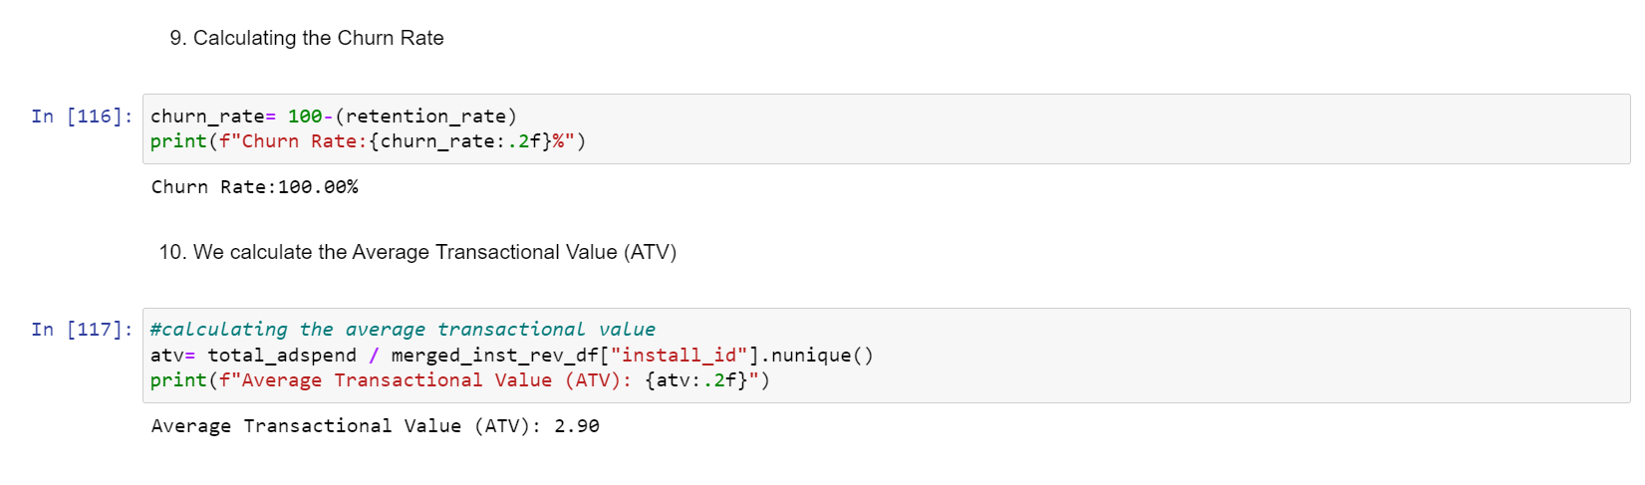
User Acquisition Process
We calculated the Churn rate and the Average Transactional Value (ATV).

Slide 49


Slide 50
CONCLUSION
The revenue database should be properly checked for the huge amount of duplicates found in the dataset
Our user acquisition strategy is very poor yielding only a 15.5% conversion rate and a -79% in return on investment.
We are not reaching our target installers (most installs) and app_id most installed through the designated ad strategy in place.
We are not reaching network_id 26 and this contributes a large part of our installs and their device os version
The company is not retaining any of its former users and thus has a very low lifetime value
The company is spending so much on network_id 10 which is underperforming
The company payouts on network_id 26 are much and when our installers uses network_id 60 the most.

Slide 51
Recommendation
First the company needs to improve its retention rate by attaching loyalty bonuses to the installed apps. For example, if a person who uses the app refers a friend, he gets some coins.
Collaborate and partner with other companies to expand the reach of the app.
Optimizing the user experience by providing a smooth, intuitive, and enjoyable gameplay experience can significantly impact retention, especially for device os versions 11, 12, and 10.
While using the app the company can incorporate in-app advertisement, so if an installer watches a video he gets some coins. This can help generate revenue.
Incorporate social and community features in apps such as multiplayer modes or leaderboards can build the engagement of the apps
Ads across other App_id except 174, 121, and 94 should be tremendously reduced and Ads focus should be on these stated App/Client_id.
Budget for Ads on network_id 10 should be allocated to network_id 26
Ads should be more focused on country_id 1 and about half the budget used for country_id 1 allocated to country_id 109
Excellent customer service should be provided to users of our app to improve the retention rate
A/B testing should be used with marketing and ads campaigns
Efforts should be put in place to reduce the payouts and identify why the company payout on network_id 26 is more.

Slide 52


